Slide 1
ESS 2023 Labs 1 Solutions

Slide 2
Which pin is which?
PD12: LED_GREEN
PD13: LED_ORANGE
PD14: LED_RED
PD15: LED_BLUE

Slide 3
Why is HAL a good idea?
HAL decouples the software and hardware being used
Makes it more straightforward to port to a different platform by modifying code in one place
Properly written HAL can make testing easier

Slide 4
How should we initialise the LEDs? Why?
We want to turn them off
Less important for LEDs, but in other devices we could be controlling (motors, actuators etc.) not initialising to 0 could be dangerous
Could want to turn things on as part of initialisation, for example slave devices that we want to send power to

Slide 5
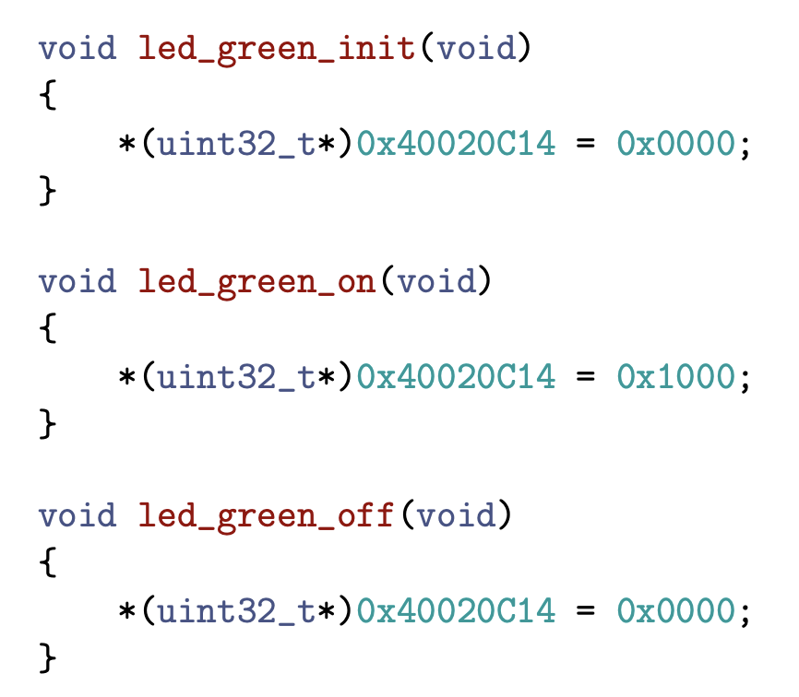

Slide 6
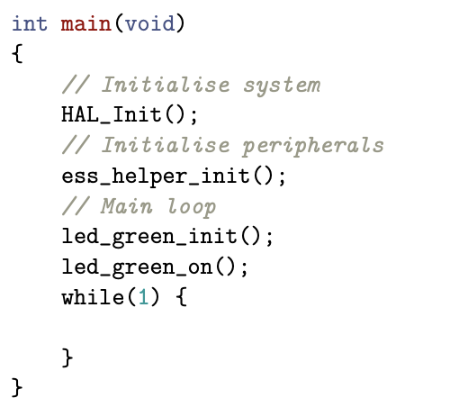

Slide 7
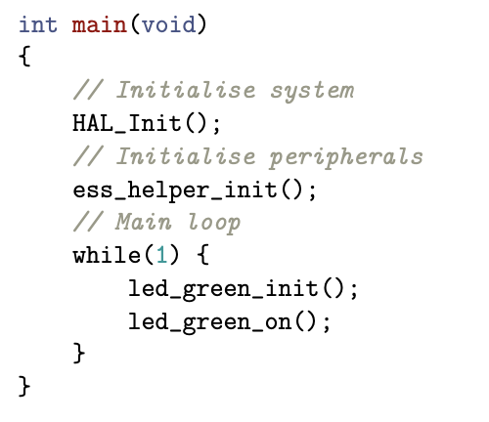

Slide 8
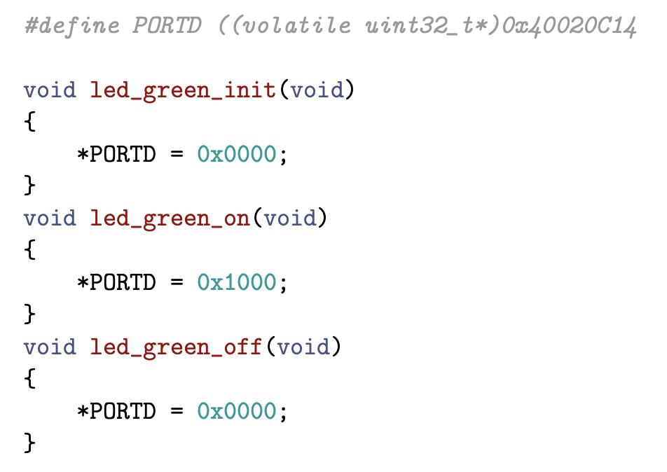

Slide 9

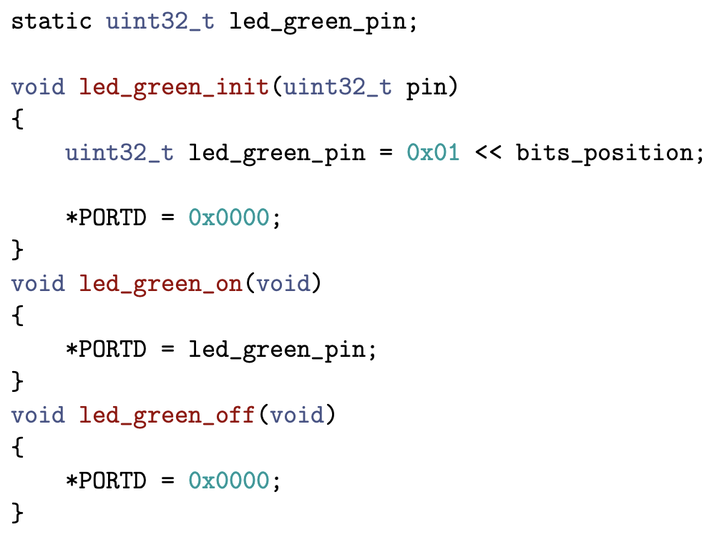
Bit shifts
Why is working?

Slide 10
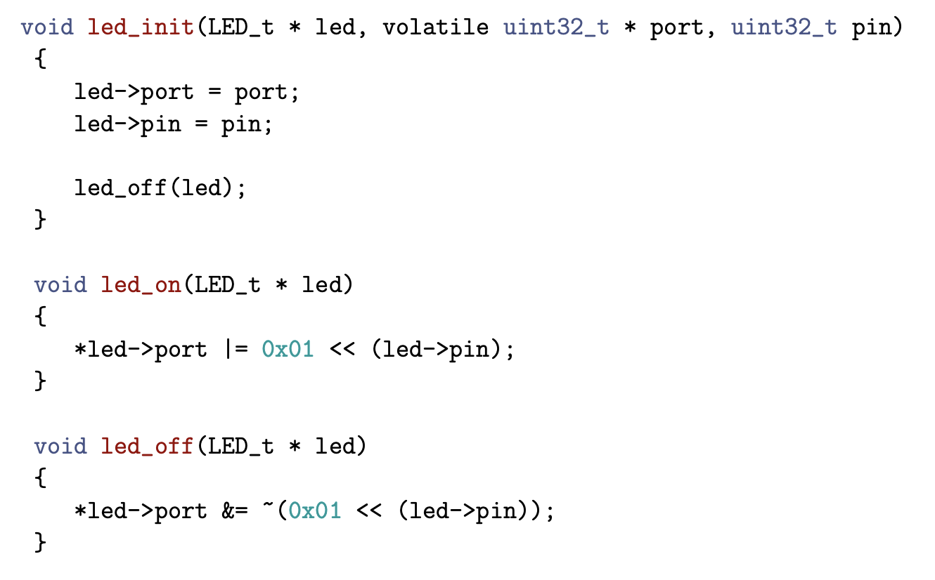

Slide 11
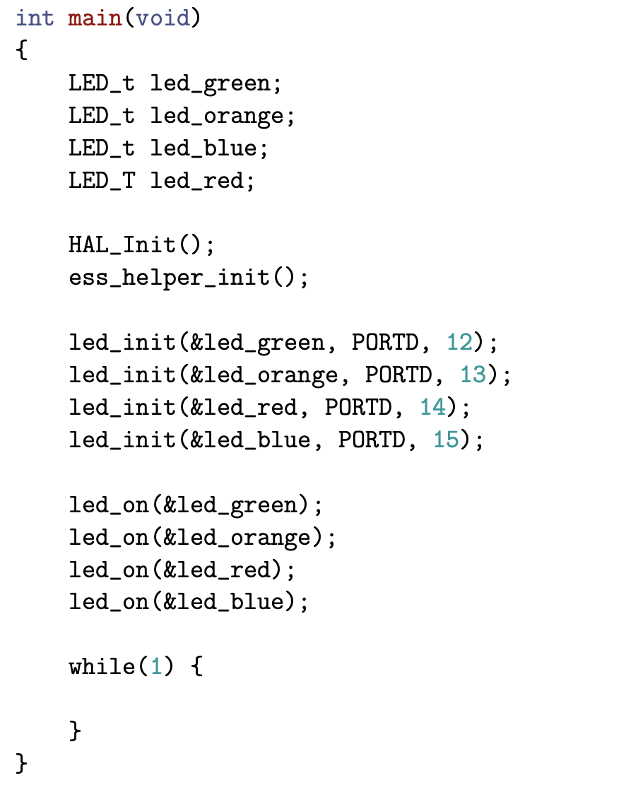

Slide 12
